Slide 1



Bangalore
ATRIA INSTITUTE OF TECHNOLOGY
DEPARTMENT OF INFORMATION SCIENCE AND ENGINEERING

Slide 2

UNDER THE GUIDANCE OF, Mrs. Vijayalakshmi V Assistant Professor, Department of ISE
Project Title
PREDICTING HEART DISEASE AT EARLY STAGES USING MACHINE LEARNING
BY,
HAJIRA KOUSAR – 1AT17IS027
SUBHASHINI D – 1AT17IS092
VARSHINI N – 1AT17IS105
Department of Information Science and Engineering

Slide 3
Contents
Abstract
Results & Discussion
7
1
Analysis and Design
Introduction
Future work to be carried
5
8
2
Software and Hardware Requirements
Literature
Survey
Conclusion
6
9
3
Methodology
References
10
4
Department of Information Science and Engineering

Slide 4
ABSTRACT
Cardiovascular diseases are the most common cause of death worldwide over the last few decades in the developed as well as underdeveloped and developing countries.
Such disease, if predicted well in advance, can provide important intuitions to doctors who can then adapt their diagnosis and dealing per patient basis and decrease the mortality rate.
Predicting and detection of heart disease has always been a critical and challenging task for healthcare practitioners. Over the years, machine learning shows effective results in making decisions and predictions from the broad set of data produced by the health care industry.
In this project, we have developed about models for heart disease prediction through the various heart attributes of patient and detect impending heart disease using Machine learning techniques.
The early prognosis of cardiovascular diseases can aid in making decisions on lifestyle changes in high risk patients and in turn reduce the complications, which can be a great milestone in the field of medicine!
Department of Information Science and Engineering

Slide 5
Introduction
According to the World Health Organization, every year 12 million deaths occur worldwide due to Heart Disease. The load of cardiovascular disease is rapidly increasing all over the world from the past few years.
Many researches have been conducted in attempt to pinpoint the most influential factors of heart disease as well as accurately predict the overall risk.
The early diagnosis of heart disease plays a vital role in making decisions on lifestyle changes in high-risk patients and in turn reduce the complications.
This project aims to predict future Heart Disease by analyzing data of patients which classifies whether they have heart disease or not using machine-learning algorithms.
Department of Information Science and Engineering

Slide 6
Literature Survey
Department of Information Science and Engineering

Slide 7
NAME | AUTHORS | YEAR | DESCRIPTION
Predicting Heart Disease at Early Stages using Machine Learning: A Survey | Rahul Katarya, Polipireddy Srinivas | 2020 | This paper provides us an idea for an automated system to predict heart disease at earlier stages using ANN, DT, RF, SVM, NB, and K-NN algorithms. (RF – 93.33%)
Heart Disease Prediction Using Machine Learning Techniques | Galla Siva Sai Bindhika, Munaga Meghana, Manchuri Sathvika Reddy, Rajalakshmi | 2020 | This paper helps us to propose a method for heart disease prediction using Machine Learning techniques, DT, Language Model, RF, and SVM. (RF – 86.3%)
Predicting Heart Disease using Machine Learning Algorithm | Anagha Sridhar, Anagha S Kapardhi | 2019 | This paper uses classification algorithm to predict small set of relations between attributes in the data bases to build a correct classifier using DT and NB algorithms.
A Comparative Study for Predicting Heart Diseases Using Data Mining Classification Methods | Isra’a Ahmed Zriqat, Ahmad Mousa Altamimi, Mohammad Azzeh | 2016 | This paper gives a brief description about the Machine Learning Classification algorithms in order to predict heart diseases from the attributes of the dataset provided using NB, DT, Discriminant, RF, and SVM algorithms. (NB – 86.12%)
Intelligent Heart Disease Prediction System Using Data Mining Techniques | Sellappan Palaniappan, Rafiah Awang | 2008 | In this paper prototype heart disease prediction system is developed using data mining classification modeling techniques, DT, NB and Neural Network. (DT – 98.15%)

Slide 8

METHODOLOGY
Our methodology uses various attributes of HD in order to identify whether a patent has HD or not.
The methodology of the proposed system is carried out in different stages which is illustrated in Figure below.
Department of Information Science and Engineering

Slide 9
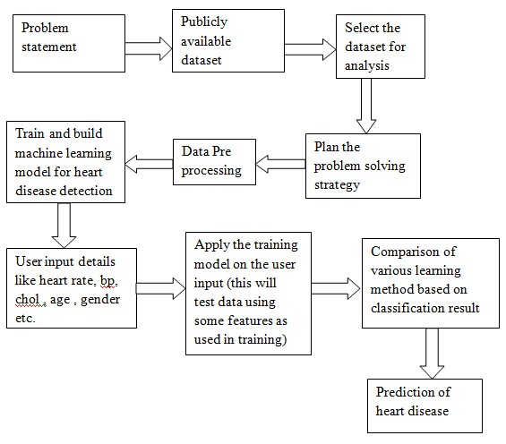
Design and approach
Department of Information Science and Engineering

Slide 10
Artificial Neural Networks ( ANN)
Artificial neural networks mainly designed for computational purposes; the main theme of this model is to do a job faster than the traditional model.
This model is similar to the biological structure of neurons in the human brain. How the neurons connect in the brain the same way here, also neurons (nodes) will connect.
This model consists of a vast number of interconnected elements (neurons) working collectively to perform a task.
Department of Information Science and Engineering

Slide 11
Support Vector Machine (SVM)
A support vector machine is a supervised learning technique in machine learning algorithms. If you give any labeled training data to support vector machine algorithms, it will produce a classifier that will divide the labeled data into different classes.
In the one-dimensional (1D) space, this classifier is called a point.
In two-dimensional (2D) space, this classifier is called a line.
In three-dimensional (3D) space, this classifier is called a plane.
In four-dimensional(4D) or more space, this classifier is called a hyperplane.
Department of Information Science and Engineering

Slide 12
K – Nearest Neighbour (K-NN)
KNN is a very simple algorithm used to solve classification problems.
KNN stands for K-Nearest Neighbors.
K is the number of neighbors in KNN.
k-NN is a type of classification where the function is only approximated locally and all computation is deferred until function evaluation. Since this algorithm relies on distance for classification, if the features represent different physical units or come in vastly different scales then normalizing the training data can improve its accuracy dramatically.
Department of Information Science and Engineering

Slide 13
Decision Tree (DT)
Decision Tree is a Supervised learning technique that can be used for both classification and Regression problems, but mostly it is preferred for solving Classification problems.
In a Decision tree, there are two nodes, which are the Decision Node and Leaf Node. Decision nodes are used to make any decision and have multiple branches, whereas Leaf nodes are the output of those decisions and do not contain any further branches.
The decisions or the test are performed on the basis of features of the given dataset.
It is a graphical representation for getting all the possible solutions to a problem/decision based on given conditions.
Department of Information Science and Engineering

Slide 14
Naïve Bayes (NB)
Naïve Bayes algorithm is a supervised learning algorithm, which is based on Bayes theorem and used for solving classification problems.
It is mainly used in text classification that includes a high-dimensional training dataset.
Naïve Bayes Classifier is one of the simple and most effective Classification algorithms which helps in building the fast machine learning models that can make quick predictions.
It is a probabilistic classifier, which means it predicts on the basis of the probability of an object.
Department of Information Science and Engineering

Slide 15
Random Forest (RF)
Random Forest is a popular machine learning algorithm that belongs to the supervised learning technique.
It can be used for both Classification and Regression problems in ML.
It is based on the concept of ensemble learning, which is a process of combining multiple classifiers to solve a complex problem and to improve the performance of the model.
The greater number of trees in the forest leads to higher accuracy and prevents the problem of overfitting.
Department of Information Science and Engineering

Slide 16

Analysis and Design
Department of Information Science and Engineering

Slide 17
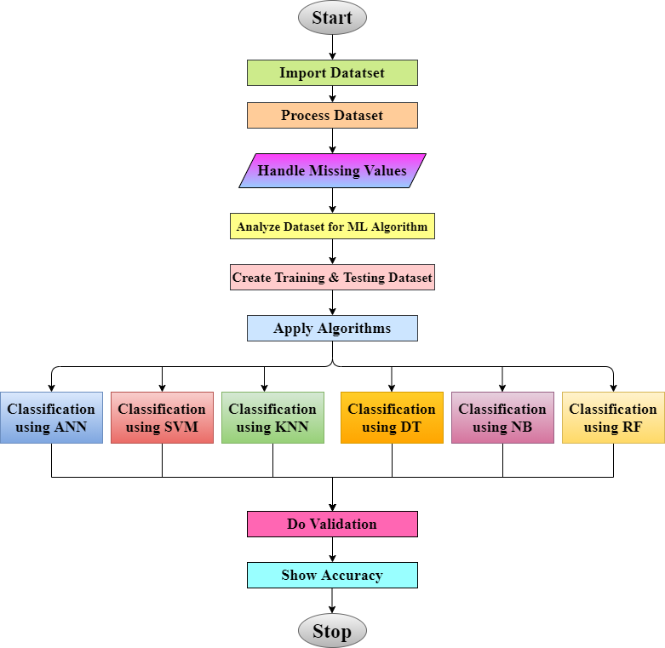
Project Flow Chart

Slide 18
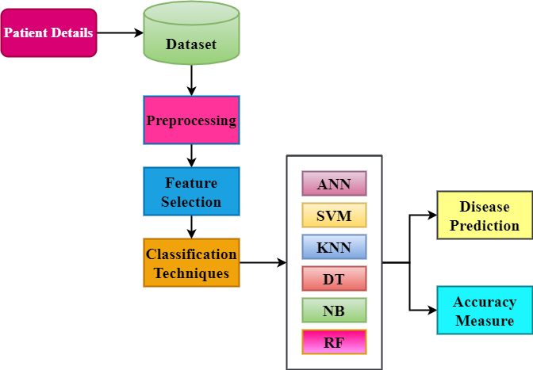
Architecture
diagram
Department of Information Science and Engineering

Slide 19
Software and Hardware Requirements
SOFTWARE REQUIREMENTS | HARDWARE REQUIREMENTS
Windows Operating System | Intel core processor
Python language | 8GB RAM
Pycharm or Jupyter notebook | Peripheral Devices
Department of Information Science and Engineering

Slide 20
Results & Discussion
In this system, training data set is tested in predicting the heart disease. 13 attributes were taken for the prediction system of the disease. Six algorithms were selected for assessment – ANN, SVM, K-NN, DT, NB, and RF. The most effective system was tested among these six algorithms. Reading found that RF was more precise in its calculation of heart disease.
The accuracy of prediction obtained by ANN is 83.61 %.
The accuracy of prediction obtained by SVM is 81.97 %.
The accuracy of prediction obtained by K-NN is 72.13 %.
The accuracy of prediction obtained by DT is 81.97 %.
The accuracy of prediction obtained by NB is 85.25 %.
The accuracy of prediction obtained by RF is 88.52 %.
Department of Information Science and Engineering

Slide 21
Conclusion
When implementing ANN, SVM, K-NN, DT, NB, and RF methods, it was found that RF gave us the best results than the other algorithms.
The accuracy that was seen in them ranged around 55% to 88% with 88.52 % being maximum.
Department of Information Science and Engineering

Slide 22
References
www.wikipedia.org
www.stackoverflow.com
www.geeksforgeeks.org
www.w3schools.com
www.tutorialpoint.com
www.javatpoint.com
www.towardsdatascience.com
Department of Information Science and Engineering

Slide 23

Department of Information Science and Engineering

Slide 24
Thank You!
Department of Information Science and Engineering

